Slide 1
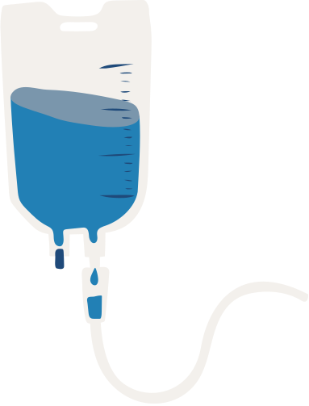
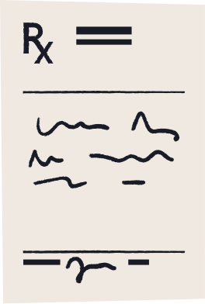

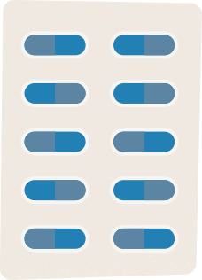
Dermatological Risk Assessment

Slide 2


TEAM MEMBERS
NAME | ROLL NO | CLASS
Siddhesh Chavan | 41 | B.Tech-5
Piyush Parekh | 27 | B.Tech-6
Pratish Khurdamoje | 34 | B.Tech-6
Aditya Pathak | 35 | B.Tech-6

Slide 3


INTRODUCTION TO SKIN CANCER
Skin cancer is the abnormal growth of skin cells, most commonly caused by ultraviolet (UV) radiation exposure from the sun or tanning beds.
It primarily affects areas of the skin exposed to sunlight and includes three main types: basal cell carcinoma, squamous cell carcinoma, and melanoma, with melanoma being the most aggressive and life-threatening.
Early detection is critical for effective treatment and better survival rates.

Slide 4
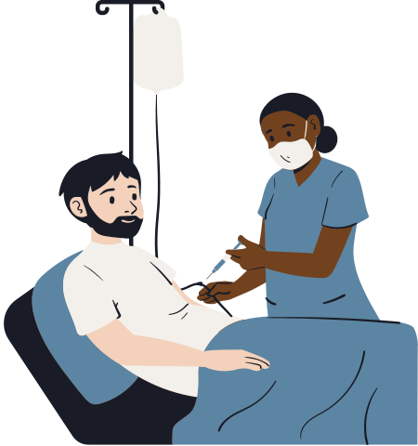
CHALLENGES IN TRADITIONAL DETECTION
Traditional detection methods (e.g., biopsies, visual examination)
Issues like late diagnosis, limited access to dermatologists, and human error
Need for automated detection systems

Slide 5


INTRODUCTION TO SKIN CANCER DETECTION
AI and ML have transformed healthcare by enabling faster, more accurate diagnostics and personalized treatments. They analyze large medical datasets, detect patterns, and assist in decision-making. ML algorithms like CNNs excel at recognizing patterns in skin images, detecting subtle differences between benign and malignant lesions for quicker, more accurate diagnoses, improving early detection and outcomes.

Slide 6

ROLE OF CONVOLUTIONAL NEURAL NETWORKS (CNNS)
Convolutional Neural Networks (CNNs) are deep learning models designed for image recognition and classification. They consist of convolutional layers that detect features like edges and textures, pooling layers that reduce dimensionality, and activation functions that introduce non-linearity. CNNs are particularly effective in detecting subtle differences in skin lesions, enhancing diagnostic accuracy for skin cancer.

Slide 7
Integrating Non-Cancer and Skin Cancer Detection
Skin Cancers
Nevus
Melanoma
Basal Cell Car
cinoma
Seborrhoeic Keratosis
Vascular Lesion
Actinic Keratosis
Dermatofibroma
Non-Cancerous Conditions
Other Random Images

Slide 8
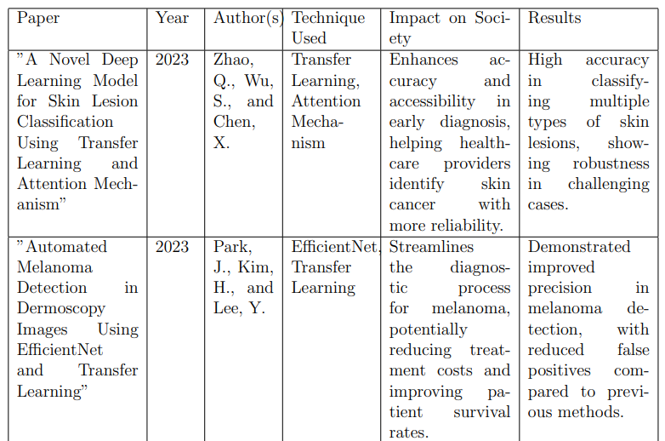
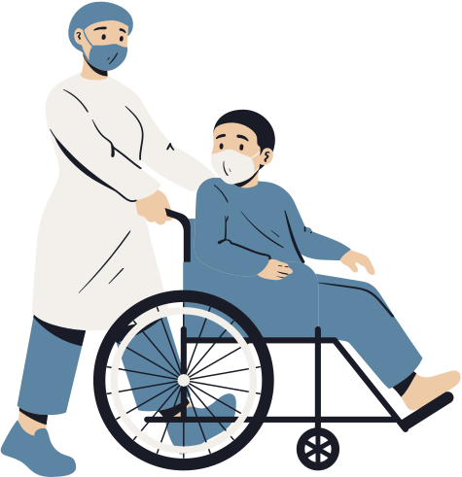
LITERATURE PAPERS

Slide 9
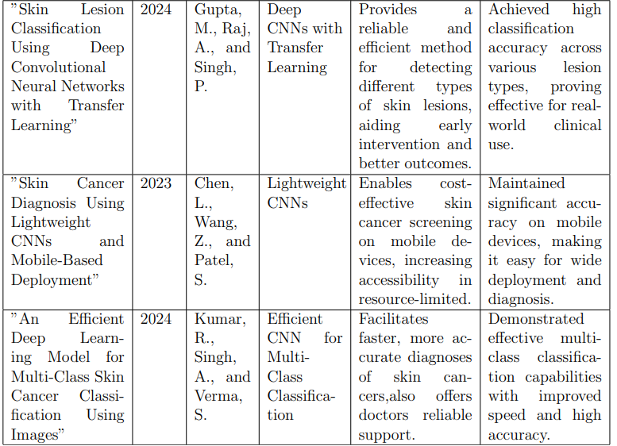
LITERATURE PAPERS

Slide 10



PROCESS OF SKIN CANCER DETECTION USING AI
The skin cancer detection process using AI involves several steps. First, data collection gathers images of skin lesions, often from sources like the ISIC Archive. Next, preprocessing prepares the data through resizing and normalization. The model is then trained with supervised learning to classify images based on labels, and its performance is evaluated using metrics like accuracy and precision to ensure effective differentiation between benign and malignant lesions.

Slide 11
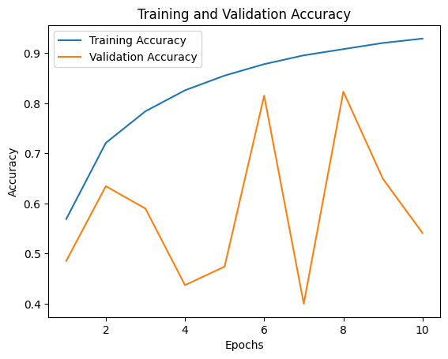
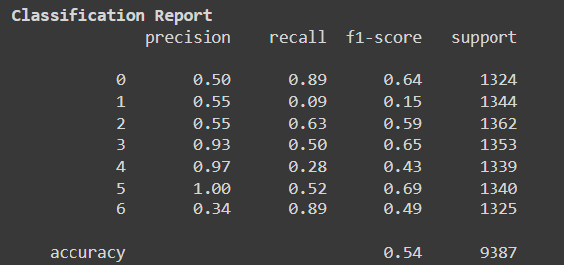
HYBRID CNN
Combines the advantages of traditional CNNs with other techniques like Recurrent Neural Networks (RNNs) or Transformer models to improve feature extraction and model performance for specific tasks.

Slide 12


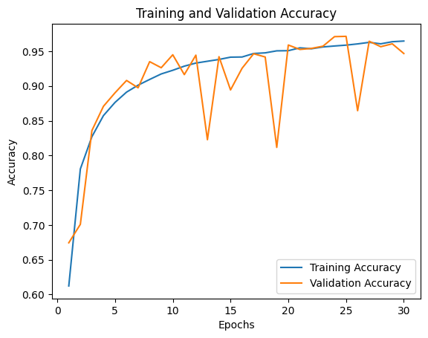
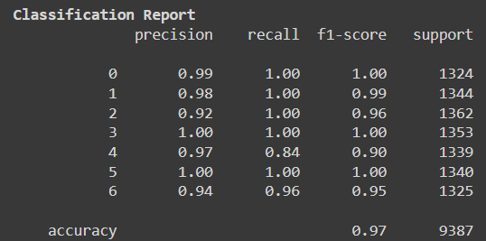

DERMANET MODEL
A CNN-based architecture specifically designed for skin lesion classification, often used in dermatology to detect skin diseases like melanoma through image analysis.

Slide 13
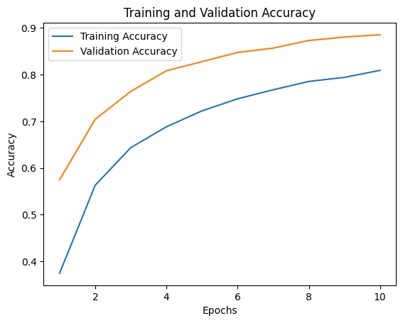
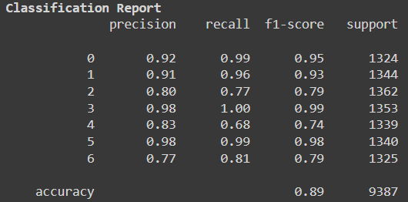
EFFICIENTNET
A family of CNN models that scale both depth, width, and resolution of the network in a balanced way, achieving high accuracy with fewer parameters and lower computational cost.

Slide 14
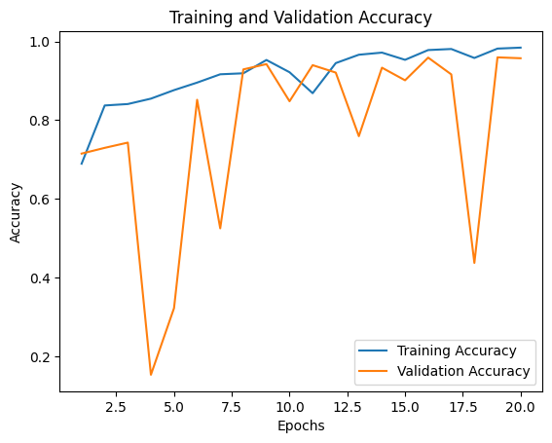
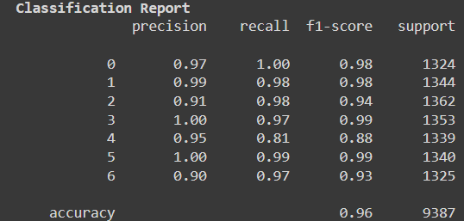
RESNET
Introduces shortcut connections (residuals) to skip layers, helping to prevent the vanishing gradient problem and enabling the training of much deeper networks.

Slide 15
Telemedicine: Bridging the Gap Between Patient and Doctor
Remote Consultation
1
Real-time interaction between doctor and patient
Image Upload
2
Patients submit skin images for diagnosis
Secure Data Transfer
3
Ensuring patient privacy and data protection

Slide 16
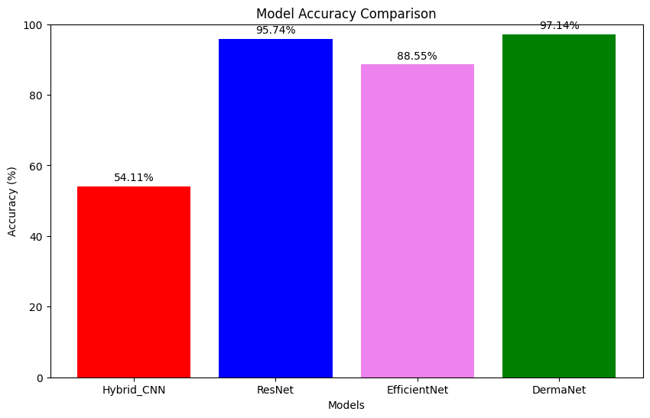
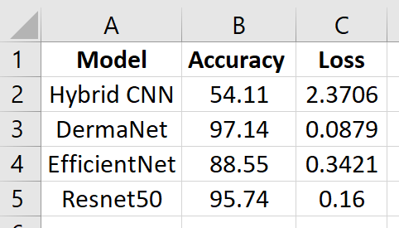
SELECTING BEST MODEL

Slide 17
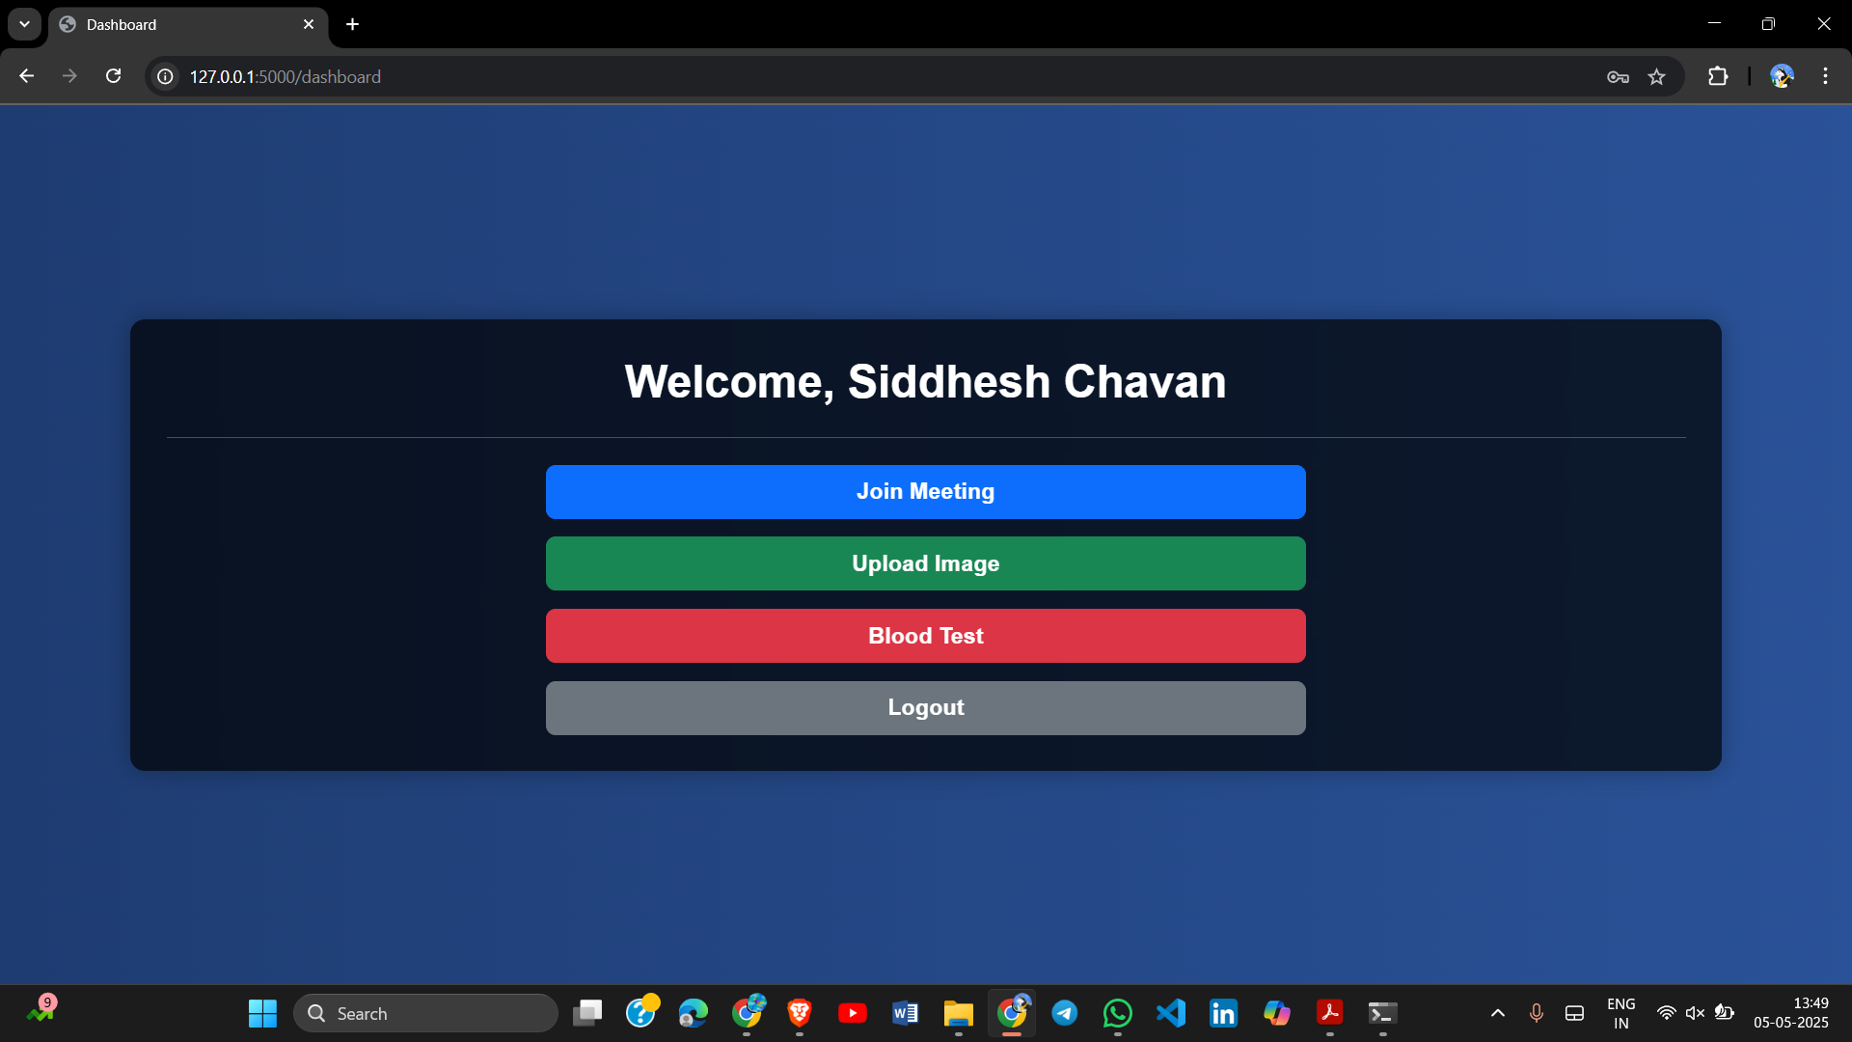

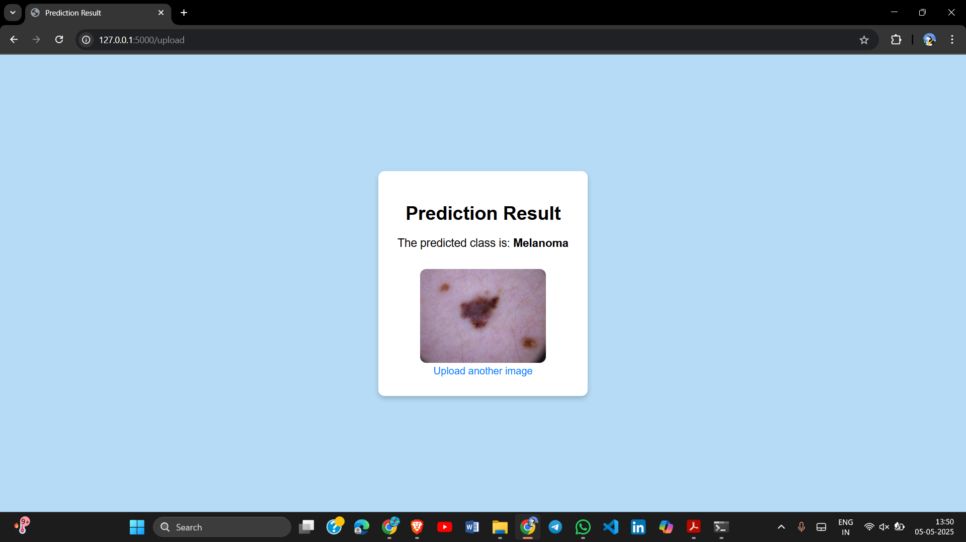
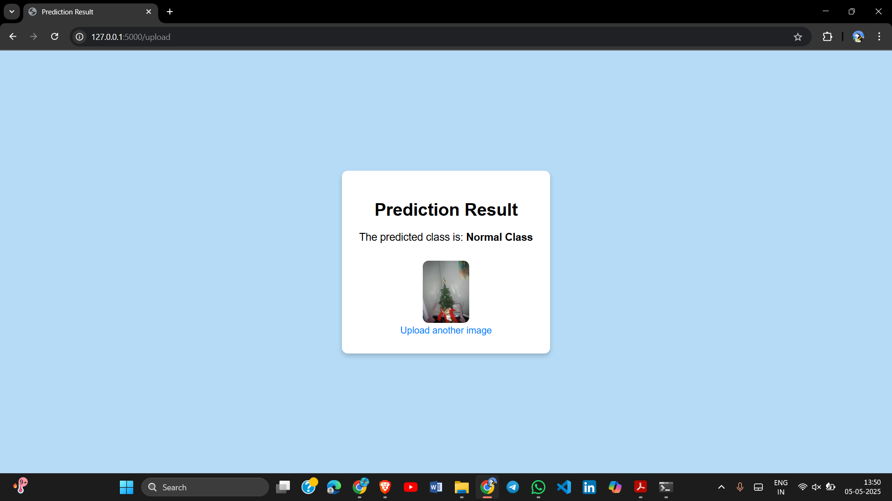
RESULTS

Slide 18
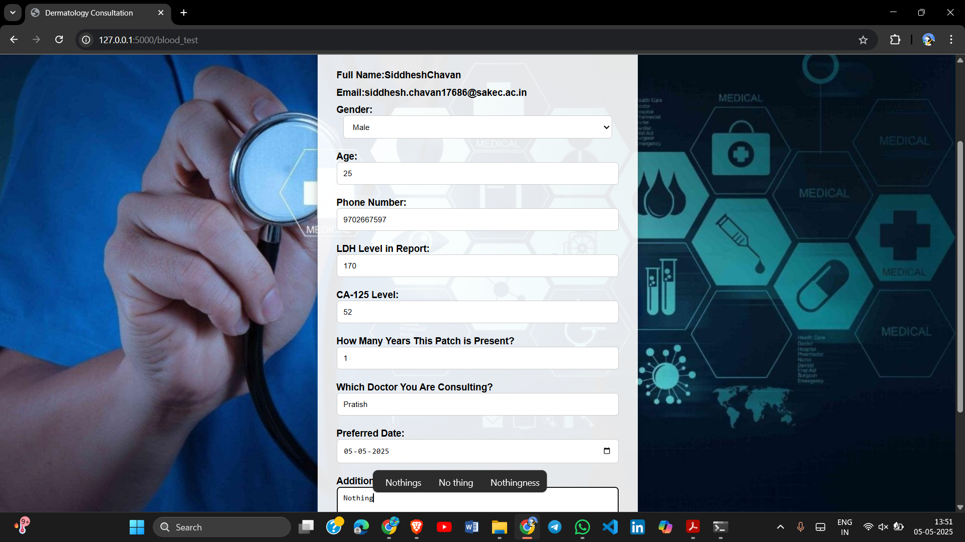
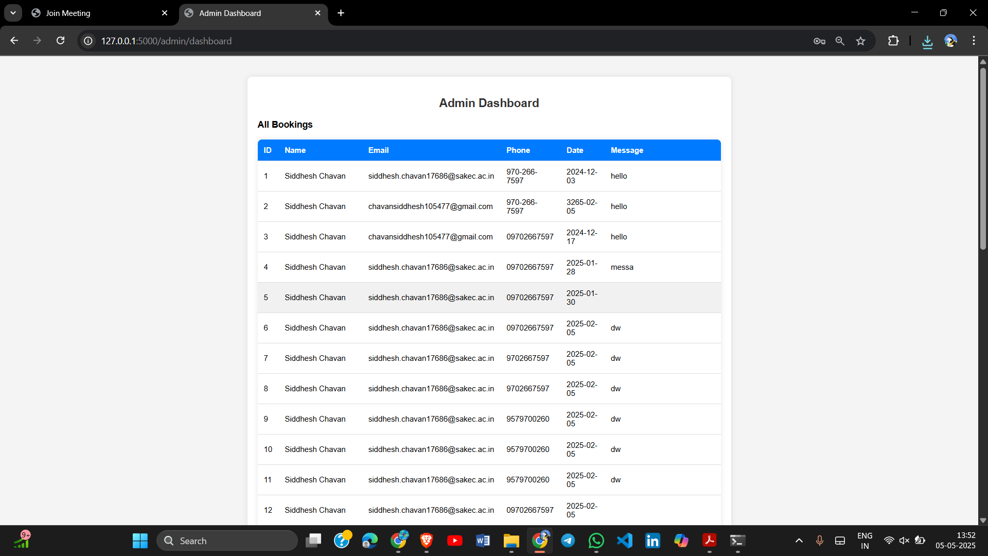


RESULTS

Slide 19
Application: Transforming Skin Cancer Care
1
Real-time skin cancer detection in clinics
2
Assistance in cosmetic dermatology for skin anomaly identification
3
Use in dermatology research for AI-based diagnostics
4
Telemedicine and Remote Diagnosis
5
Helps medical students learn skin cancer detection

Slide 20

CONCLUSION
In this project, a comprehensive system for skin cancer detection and patient support was developed. The primary component is a hybrid CNN model, named hybrid_cnn, which integrates LSTM layers to enhance prediction accuracy. Unlike the earlier version that only recognized 7 skin cancer types and accepted only valid skin images, the improved model now ensures more reliable classification by filtering out non-skin images, thus preventing misuse or irrelevant inputs.
Additionally, the project expands beyond diagnosis by incorporating vital patient care features such as video consultations, appointment scheduling, basic blood test data integration, and automated email alerts for any detected issues. These enhancements offer a more holistic and accessible solution for early cancer detection and medical support.

Slide 21
REFERENCE
[A Novel Deep Learning Model for Skin Lesion Classification Using Transfer Learning and Attention Mechanism (2023)] – Zhao, Q., Wu, S., and Chen, X.
[Automated Melanoma Detection in Dermoscopy Images Using EfficientNet and Transfer Learning (2023)] – Park, J., Kim, H., and Lee, Y.
[Skin Lesion Classification Using Deep Convolutional Neural Networks with Transfer Learning (2024)] – Gupta, M., Raj, A., and Singh, P.
[Skin Cancer Diagnosis Using Lightweight CNNs and Mobile-Based Deployment (2023)] – Chen, L., Wang, Z., and Patel, S.
[An Efficient Deep Learning Model for Multi-Class Skin Cancer Classification Using Images (2024)] – Kumar, R., Singh, A., and Verma, S.

Slide 22
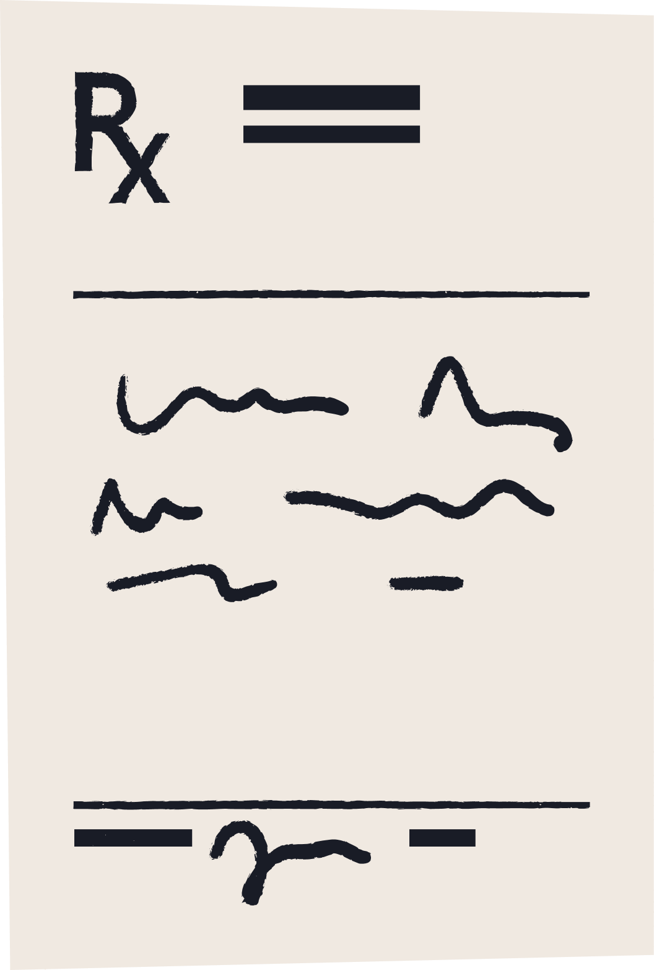


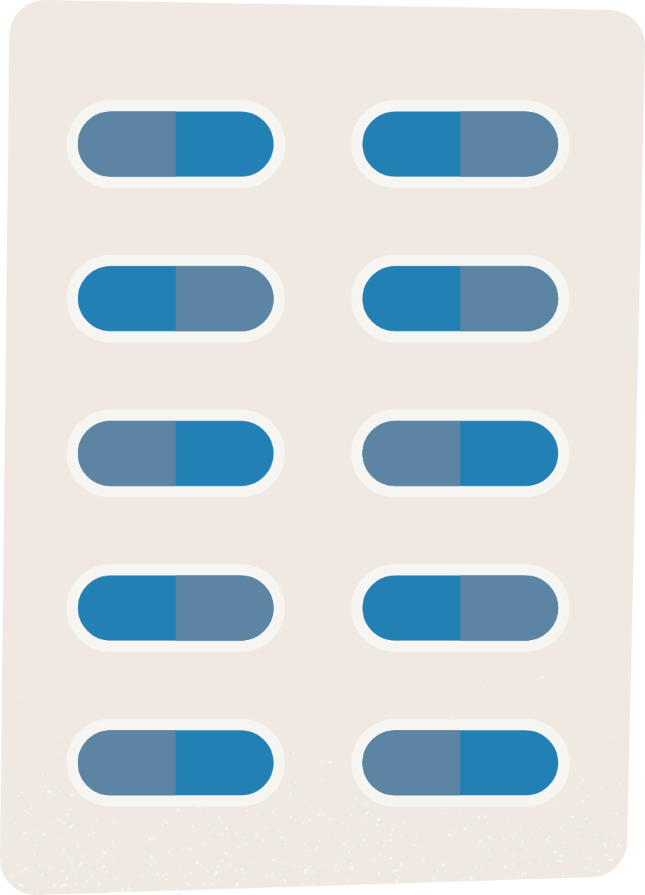
THANK YOU

